Slide 1
Enhancing Web Application Security with Secure Hardware Tokens
Web Cryptography Next Steps
10-11 September 2014
Mountain View, California, USA
Dr. Karen Lu, CISSP, CCSK

Slide 2
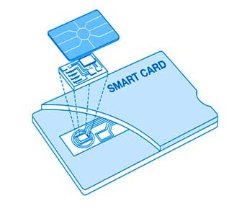
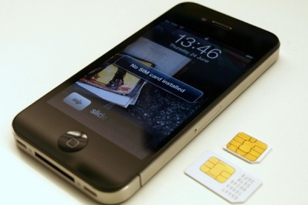
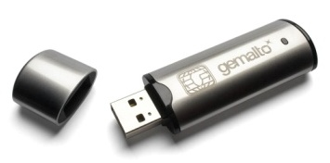
Secure Hardware Tokens
Secure microprocessor, secure memory, crypto engine

Slide 3
Providing security for many domains

Slide 4
No standard for web applications to use secure hardware tokens
September 8, 2014

Slide 5
Secure hardware tokens
Web applications

Slide 6
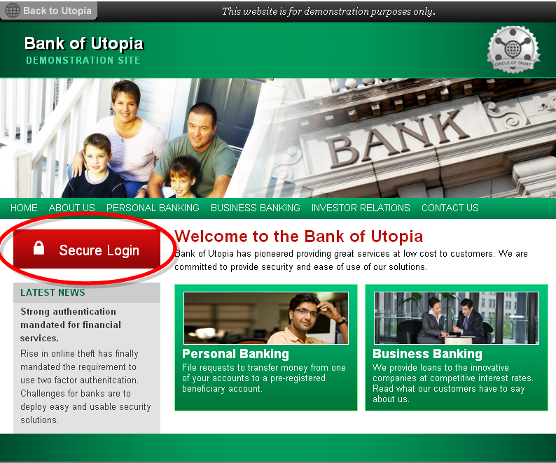
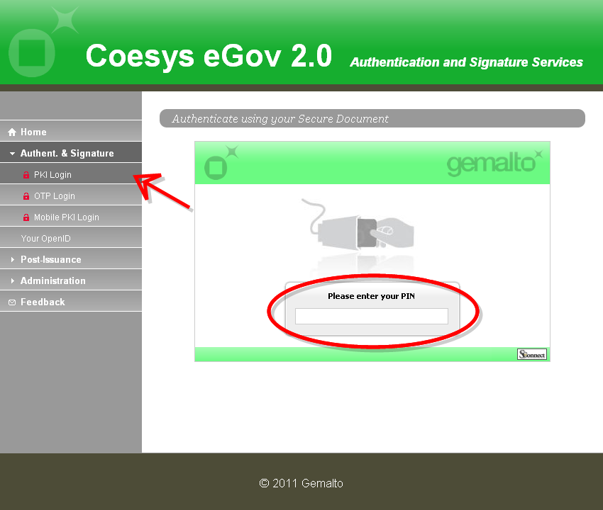
Authentication, signature, encryption
Notes:
With the proprietary solution, we are able to provide secure token-based services for web applications, for example, strong authentication, digital signature, and data encryption.

Slide 7
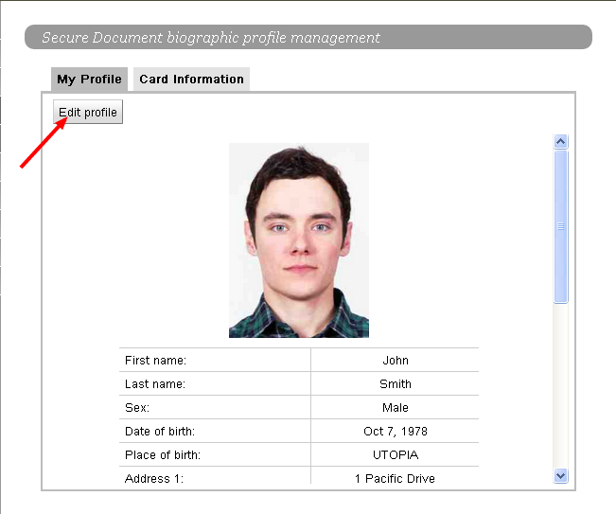
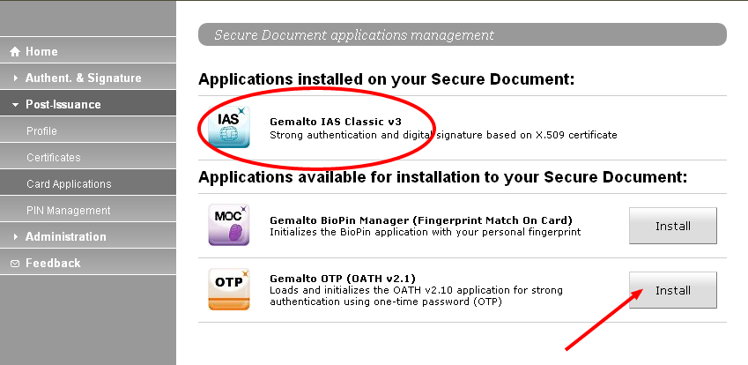
API key protection
Remote provisioning
WebRTC
Notes:
We are also able to support new applications, such as …

Slide 8
Secure hardware tokens
Web applications
Notes:
Other companies also built their own proprietary solutions (own bridges).
Problems of proprietary solutions
Providers: build for each browsers, maintain
Developers: adopt, deploy
Users: software download
All: not interoperable

Slide 9
Standardize how web applications communicate with and use secure hardware tokens.
Application Programming Interface (API) & Access Control
Notes:
W3C can solve these problems by standardizing how web applications communicate with and use secure hardware tokens. This will allow web applications to utilize additional security and privacy provided by the tokens, enable interoperability, and improve usability.

Slide 10
Secure hardware tokens
Web applications
Notes:
Which level should we build the API? Or Where should we build the bridge? We propose three levels of APIs and let W3C to decide which level to focus on.

Slide 11
API level | Function
Low | Communication and basic access (APDUs)
Monday, September 08, 2014
Notes:
The low level API is at the communication level. It enables web applications to communicate with secure hardware tokens using APDU. We already have a draft proposal called secure element API
Pros
W3C proposal for Secure Element API
Based on ISO 7816
Access all and future functionalities
Cons
Deal with low level communication

Slide 12
API level | Function
Medium | Crypto and secure storage
September 8, 2014
Notes:
The mid level API enables web applications to use the crypto and storage functionalities of the secure hardware token
Pros
W3C WebCrypto API extension (token, key discovery)
Easier to use than low level API
Cons
Middleware
Cannot quickly access new token features

Slide 13
API level | Function
High | Security services (e.g. authentication, payment, token management)
September 8, 2014
Notes:
The high level API enables web applications to support a specific service, online payment (EMV), authentication (FIDO), and token management (GP).
Pros
Easy access to services
Cons
Middleware
Maintenance when applicative standard evolves

Slide 14
API level | Function
High | Security services (e.g. authentication, payment, token management)
Medium | Crypto and secure storage
Low | Communication and basic access (APDUs)
September 8, 2014

Slide 15
Who can access the secure hardware token?
September 8, 2014
Notes:
The secure hardware tokens contain secret or private keys for their users. The token has many built-in security mechanisms to protect the keys and the operations, such as physical sensors, secure algorithms, user authentication, and try-counters. Access control is another important mechanism that manages which applications can use which functionalities of the token. In the following, we discuss two access control options. Each of them should also have user consent for each website as an additional control.

Slide 16
User agent controls access
User Agent
Secure hardware token
Cachedaccess rules
Access rules
Web Application
Access control enforcer
Secured resource
http://opoto.github.io/secure-element/
September 8, 2014
Notes:
Application based access control
This method requires collaborations between the secure hardware token and a trusted entity, called Access Control (AC) enforcer, which resides on the host side. For a mobile device, the AC enforcer belongs to the OS. The token maintains a list of access control rules. When an application requests to communicate with a secure hardware token, the AC enforcer fetches the access control rules from the token and checks the application against the rules to decide whether to allow the access.
Token has AC rules; User Agent helps to enforce it

Slide 17
Token controls access
Secure hardware token
User Agent
Access rules
Web Application
Access control
Secured resource
September 8, 2014
Notes:
Origin based access control
Token has AC rules that includes origins; User Agent verifies or sends application origin
Feature
Token controls the access
Less change in the user agent
Burden
Need more changes in the token

Slide 18
Recommendations
Consider all these proposals
Leverage the existing proposal
September 8, 2014

